Slide 1
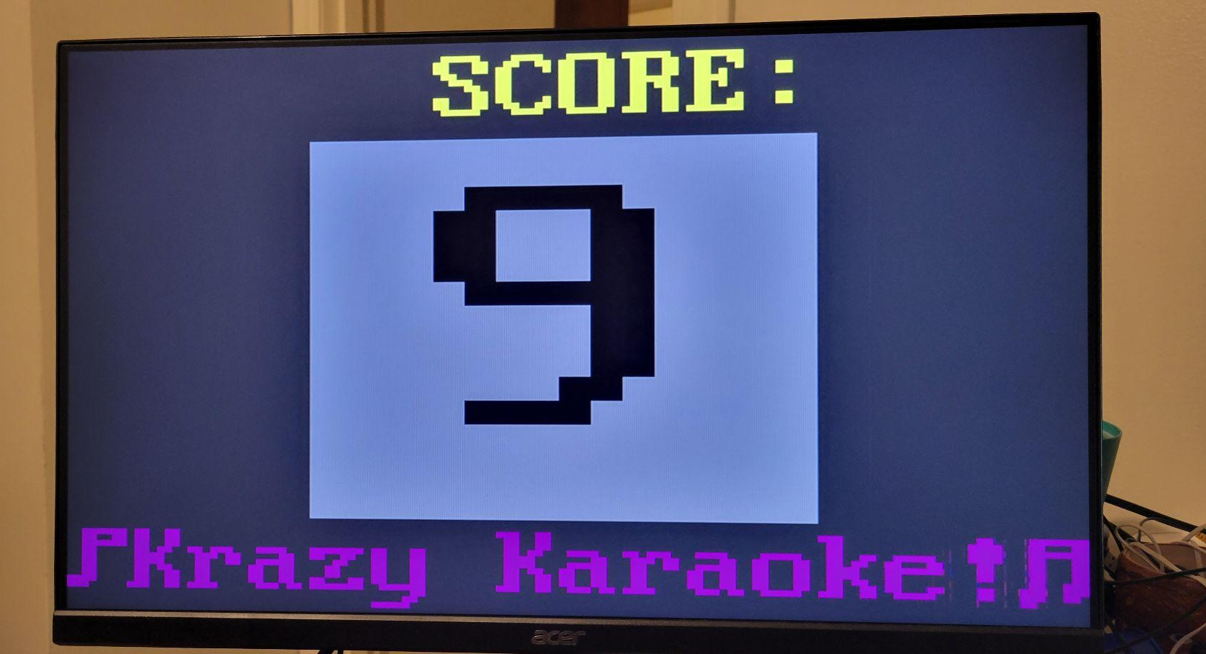
Krazy Karaoke:
The Final Countdown
Team Members:
Joe Biernacki
Ian Chadwick

Slide 2
Project Goal/Motivation
Our aim was to learn about, and utilize some of the features that make FPGAs useful in real world applications in fun and demonstrable way.
We decided to create a Karaoke game because that would let us learn to use:
ADC
DSP
VGA
Audio Output
We thought Krazy Karaoke would be a fun and interactive way to show these features that could also be played as an actual game.
The project could also be generalized to frequency (pitch) detection hardware

Slide 3
High-Level Overview of Functionality
To play the game a player would:
Press start to record a reference track that they want to sing into the FPGA
Switch the recording bank and press start
Sing the song, attempting to match the notes and timing of the reference song
The average of the scores for each note will be displayed on the VGA as the scoring module produces them.
When the song is over the score displayed is the overall average score

Slide 4
High-Level Overview of Functionality (Cont.)
Microphone:
3.5mm microphone input is passed in through a ¼” audio cable
Circuit:
XADC port requires input biased at .5V, so it is passed through circuit first
Memory:
The raw ADC output goes to memory
FFT:
The raw ADC output is then processed by the DIT FFT to get a frequency for a time window
Reference Song:
In the user first step, the reference song frequencies are stored in the reference frequency FIFO as they are completed.
Singing:
Once the user starts singing, the sung frequencies are processed by the FFT and placed in the song frequency FIFO
Score:
As long as there is an element in each of the FIFOs (ref and song) the scoring module will pop the next frequencies off of the FIFOs and score the accuracy

Slide 5
High-Level Specification
In order to accomplish the goal, the design had to:
Convert raw audio input to digital signal
Convert digital signal to a frequency
Compare the frequencies and score
Display score and output audio

Slide 6
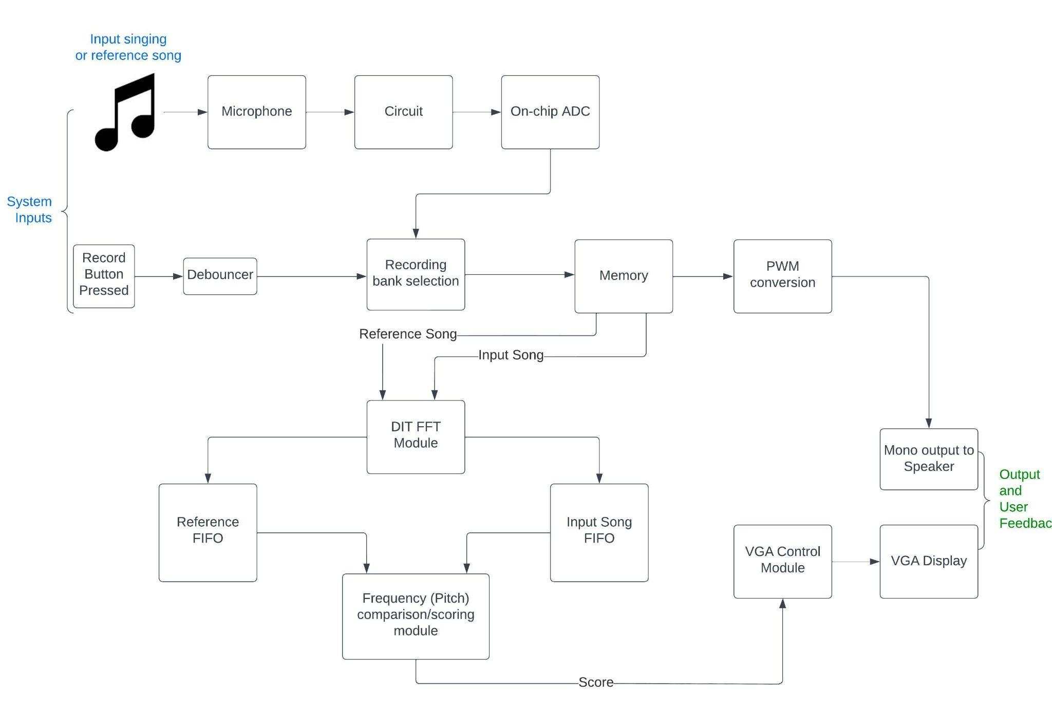
High-Level Specification(Cont.)

Slide 7
Detailed Functionality Description
The design can be broken down into three core components of the overall workflow:
Analog sound waves to block RAM
Digitized audio to frequency domain
Comparing and scoring frequencies

Slide 8
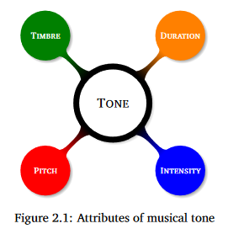
Constraining the Problem
For the song to sound good, and to score well in the game, a singer needs to be:
In-time
In synch with music/reference song.
(the right note at the wrong time will sound “off”)
Part of the game (and music in general) is being in time with the music, so the user will need to ensure they are in-time
In-key
The right note that goes with the music/reference song.
(the wrong note at the right time will also sound “off”)
The pitch of an isolated voice or instrument is equivalent to its frequency
Pitch = Frequency = Note*

Slide 9
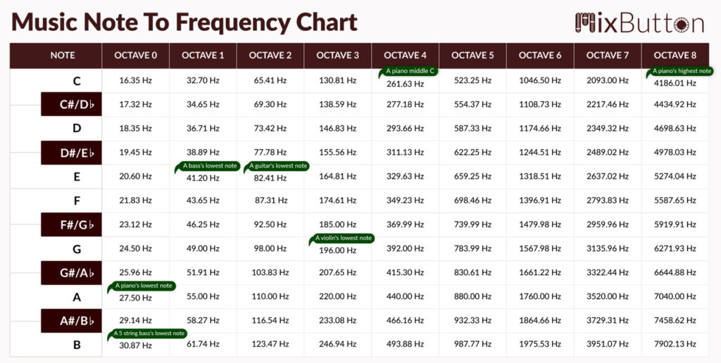
A Note on Notes and Octaves
The notes are a continuous (periodic) spectrum from ~16Hz-8kHz
Every note (C, D, E, F, G, A, B, etc.) has 8 analogous notes in each octave, either above or below it.
A note an octave below is ½ the frequency of the note above it
You can sing the same note in a different octave and it will still sound in-key.

Slide 10
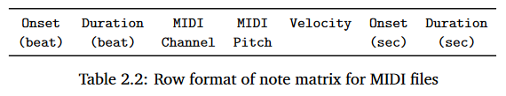
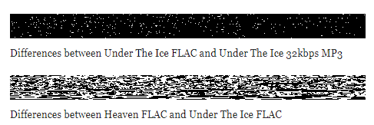
Comparing Pitch/Frequency
Since Pitch = Note = Frequency
We can compare the frequency of the sung track to the frequency of the reference track to see if it’s the same note (or the same note in a different octave)
Decided to use FFT to get frequency from ADC output
Originally were going to use MIDI or Chromaprint to compare
Both required additional processing that was unnecessary if we already had the frequency

Slide 11
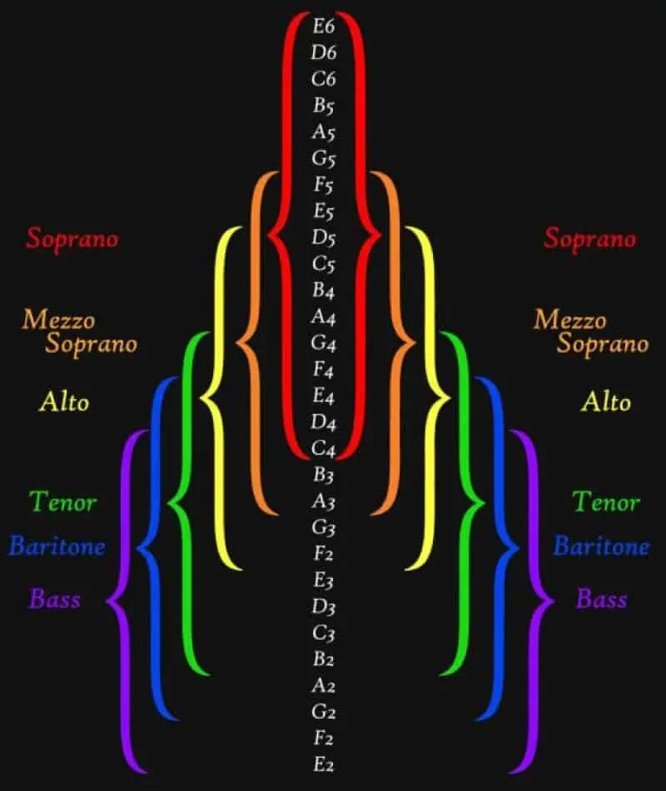
Developing Heuristics
The range of human hearing is ~ 20Hz - 20kHz
Music notes range from ~16Hz to ~7.9kHz
Additionally the range of notes a human can produce is limited
This means we could focus less on edge cases and use these constraints/heuristics to calculate all octave frequencies of an arbitrary input reference frequency for comparison to the sung frequency.

Slide 13
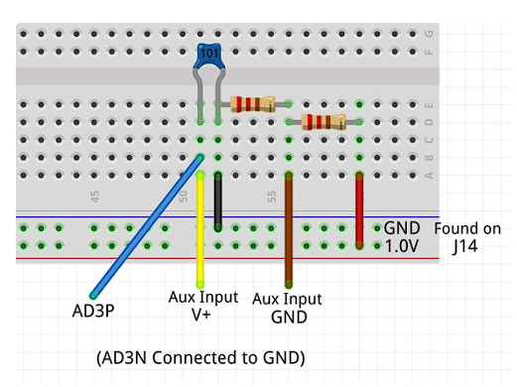
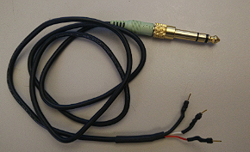
Component 1: Getting analog sound into the FPGA
The first component of the project was getting analog sound waves into a digital format on the FPGA.
Originally were going to use MEMs microphone, but switched to external mic connected to ADC
Were able to use Digilent ADC/Sound demo as a basis for our ADC and sound output portion.
Had to build circuit and modify wiring to allow us to provide the input the XADC was expecting:

Slide 14
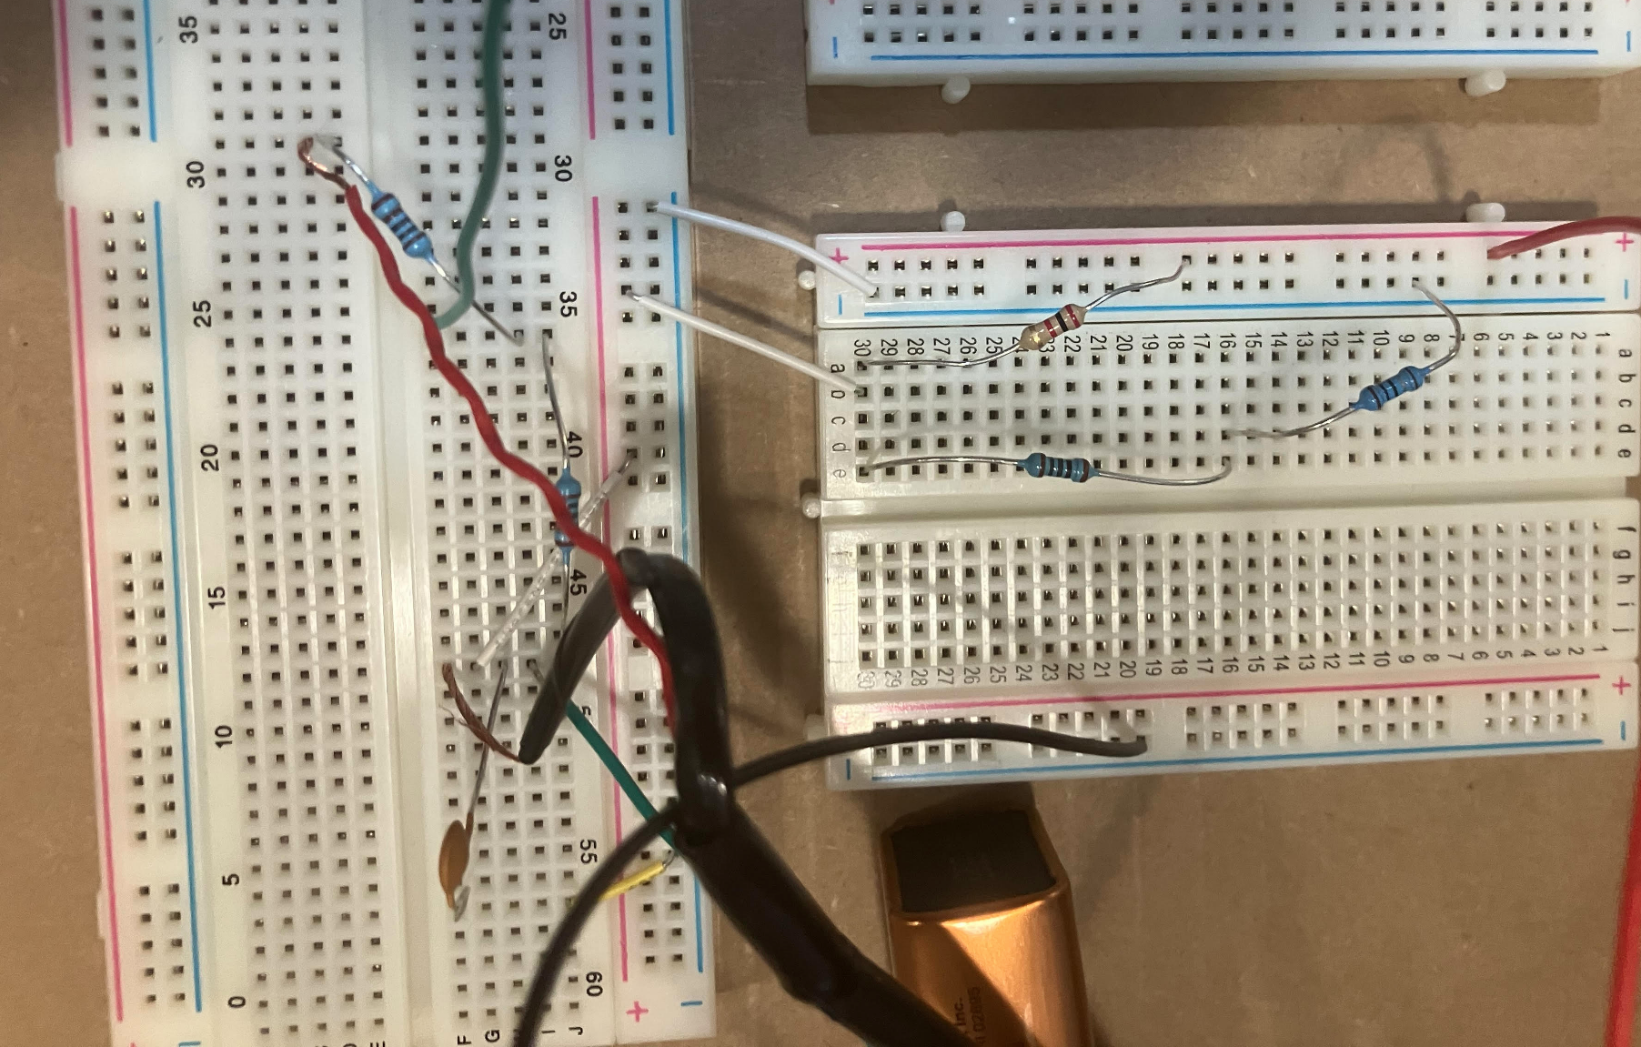
Component 1: Getting analog sound into the FPGA
Challenges
Variable A/C voltage from phone
Lack of reliable supply voltage for divider (for biasing input wave)’
0 - 1V requirement required a second voltage divider
Cabling

Slide 15
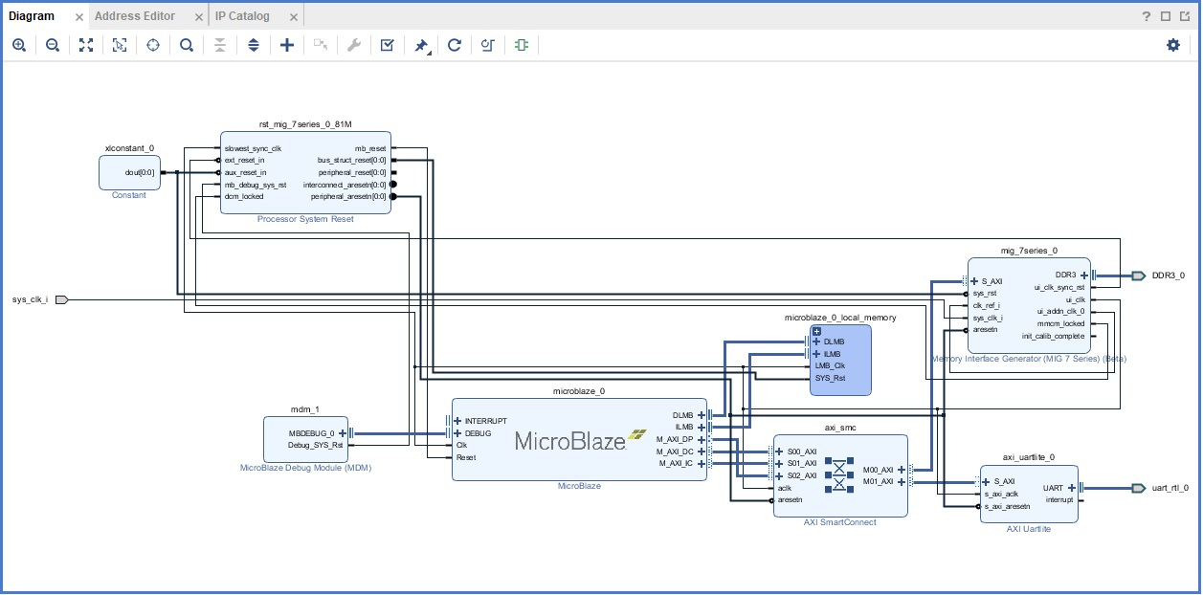
Component 2: FFT
Originally we were going to use the Xilinx IP cores to do all of the DSP.
However all of the DSP IPs required the use of the Microblaze soft microprocessor and the AXI interface and the Vitis SDK
This would have required a co-MCU be instantiated with a C program installed its memory to process the data we sent it from our modules.
Decided to pivot away from that and implement the DIT FFT in pure Verilog

Slide 16
Component 2: FFT
Frequency detection was more challenging than expected
Bins + buffers
Alternative approach; zero crossing

Slide 17
Component 3: Comparing/Scoring
The FFT module will output into one of two FIFOs.
First during the reference song recording and transform, the resulting frequencies go into the reference FIFO
During the singing portion, the frequencies go into the song FIFO
The “valid” signals from each FIFO are ANDed together to provide the “start” signal to the Comparison/Scoring state machine.
Once the start is received, the state machine will pop the next value off of each queue and register the values.

Slide 18
Component 3: Comparing/Scoring
The octave of the reference frequency as well as all the octaves above and below are then calculated (using bit shift multiplication) in one clock cycle.
These frequencies are then put into the appropriate octave bins in the next clock cycle
The sung frequency is then compared to each of these bins +/- an accepted range and an output score is calculated.
(the range depends on the octave)
The output score is then captured by a tally module, which keeps the average and then output to the VGA display.

Slide 19
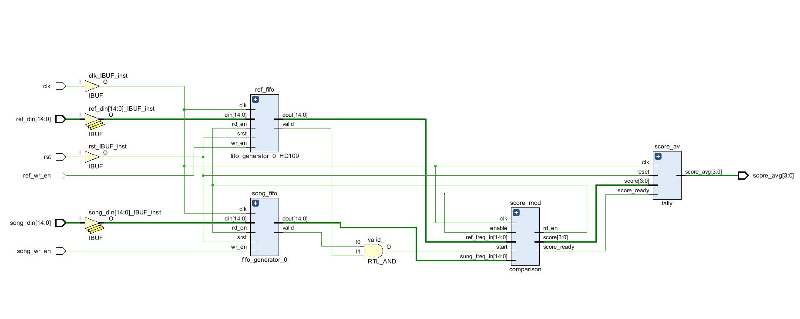
Component 3: Comparing/Scoring

Slide 20
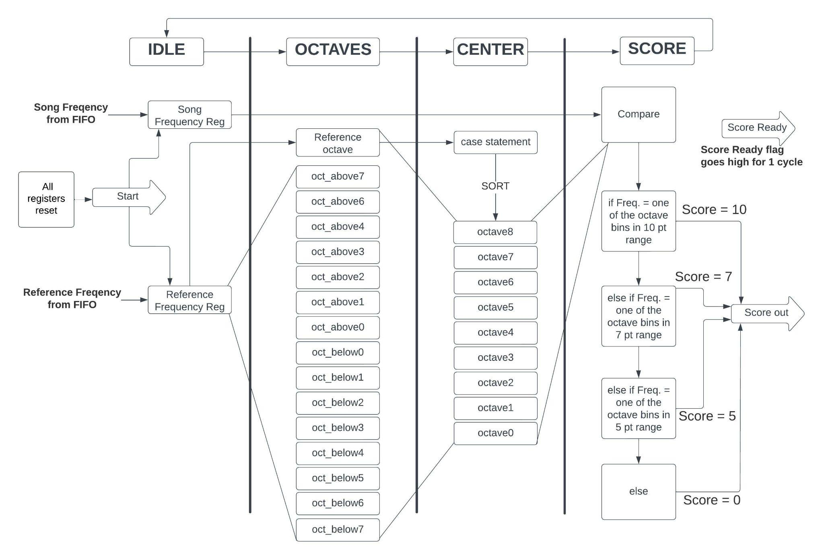

Slide 21
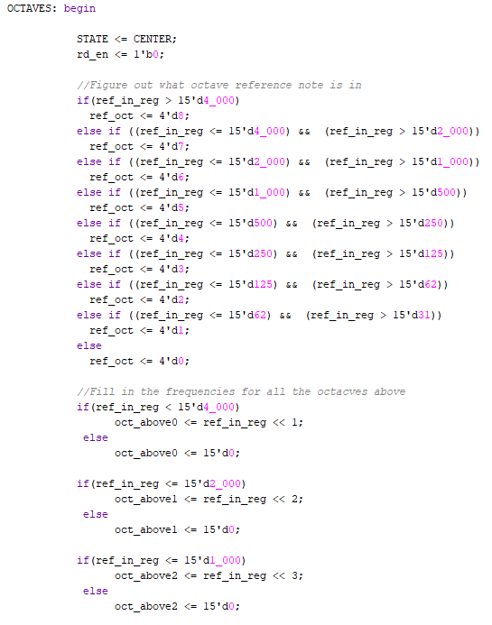
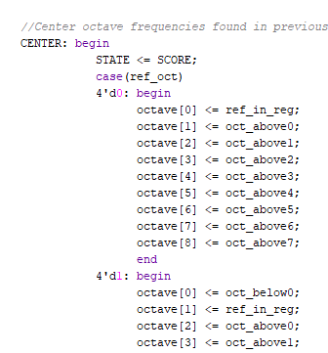
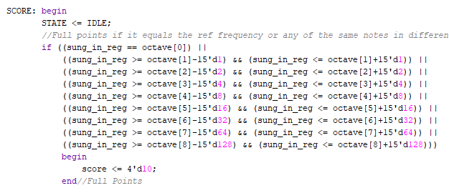

Slide 22
Component 3: Design Considerations
We wanted to make the calculation for getting a score as fast as possible to increase performance.
The tradeoff was that we had to increase the overall area of the design by implementing some hardware to calculate values that might not get used (octaves above and below)
The FIFO was used to ensure that the order in which frequencies were compared is correct.
The largest performance bottleneck will be waiting for the user to sing in enough of the song for the FFT module to calculate the next frequency to compare.

Slide 23
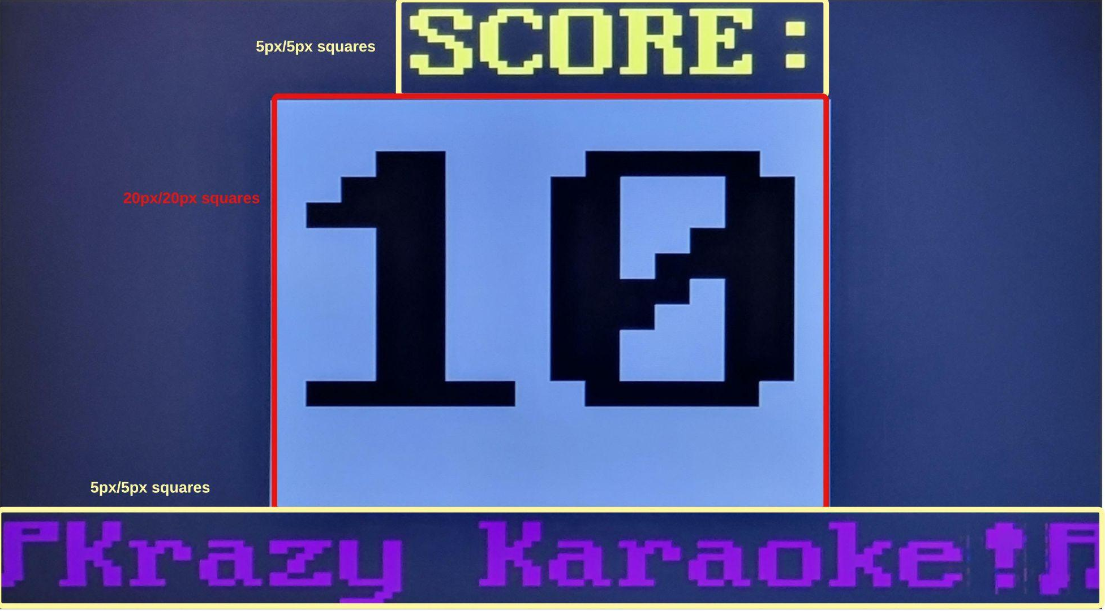
Displaying Score
The VGA code is modified from the provided Lab 1 code.
Each rectangle is divided into 16 rows that correspond to a register with bitwidth = to the number of columns.
A 1 in the corresponding position of the register causes the square to be in the “on” state and a 0 in the “off” state.
Adjusting the values of the registers changes the pattern displayed.

Slide 24
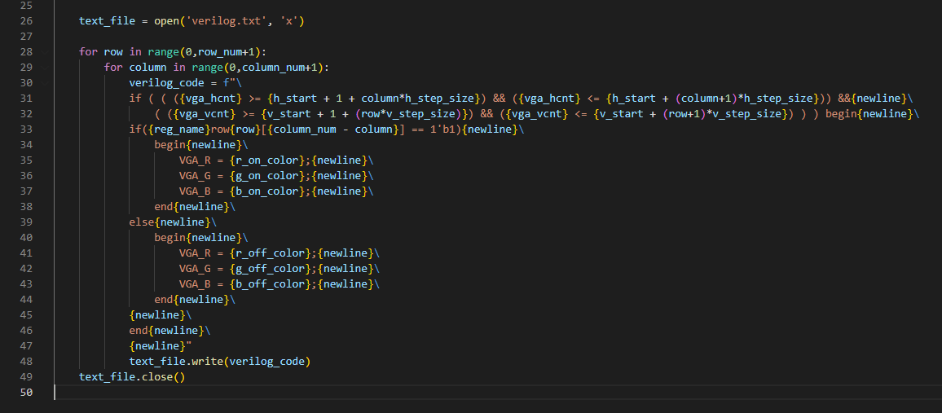
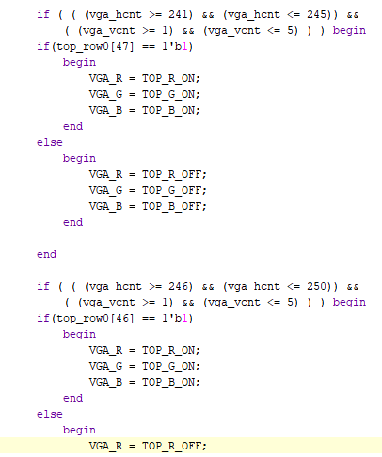
Python Script to generate VGA Verilog code
Generating matrices in verilog was tedious, so we made a python script to make the matrix code.
This code can be used to easily implement simple graphics.

Slide 25
Failures:
Musical Knowledge
We had made some assumptions that turned out to be incorrect
There was a big knowledge gap about music as a signal/frequency that we had to fill
IP Cores
Spent time trying to figure out MicroBlaze and AXI to use IP cores and didn’t end up using those.
Integration:
Built the project from the bottom up
Have many of the components complete
Ran out of time to integrate all the components and get a complete game running on the FPGA

Slide 26
Successes:
We met our specification requirements:
Component 1:
Framework for getting analog audio from a microphone into the FPGA block RAM.
Component 2:
FFT module that converts ADC output to frequencies
Component 3:
Compares frequencies of and scores them based on how close they are
VGA output

Slide 27
Attribution of Work:
Research and Designing System:
Ian
Joe
XADC/Audio Demo
Mostly Joe
Ian
DIT FFT
Joe
Scoring
Ian
VGA Display
Mostly Ian
Joe

Slide 28
Questions?

